Slide 1
JAX-WS Proxies
Service-Oriented Software Engineering
Software Institute
Nanjing University
Bei Jia

Slide 2
JAX-WS Proxies (1/2)
JAX-WS, like its predecessor, JAX-RPC, is designed so that programmers can invoke a Web service just as through they are invoking a Java method
  The Web service on the remote host needs to provide a WSDL interface (including a wsdl:portType definition)
  JAX-WS provides a standard WSDL to Java mapping that maps a wsdl:portType to a Java interface. Such an interface is called a service endpoint interface (SEI) because it is a Java representation of a Web service endpoint
  At runtime, JAX-WS can generate an instance of a SEI that enables the programmer to invoke a Web service by invoking a method on the SEI

Slide 3
JAX-WS Proxies (2/2)
The technology employed by JAX-WS to create a run-time instance of a SEI is the dynamic proxy class (java.lang.reflect.Proxy), which enables JAX-WS to dynamically create (i.e., to create at runtime) an instance of a SEI that can be used to invoke a Web service
The internal workings of a JAX-WS proxy are based on an instance of java.lang.reflect.InvocationHandler that implements a standard WSDL to Java and Java to WSDL mapping
  In essence, when you invoke a method on a proxy, the internal InvocationHandler converts the parameters into a SOAP message that is sent to the Web service endpoint
  Likewise, the SOAP response message is converted into an instance of the SEI return type

Slide 4
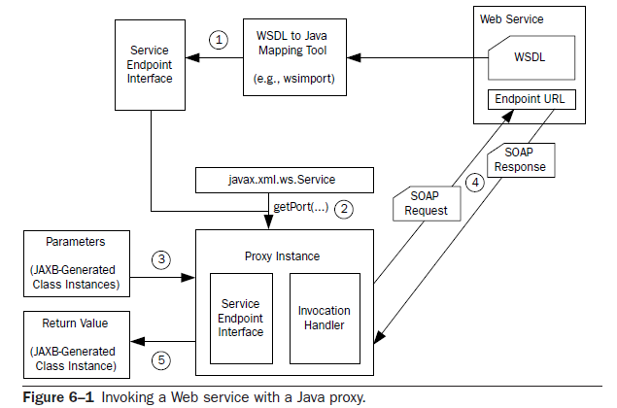
Invoking a Web service with a Java proxy
According to binding, a SOAP request is converted from the invocation, and sent to Web Service’s provider
Prior to compiling and running, SEI is generated
Invoke a method from SEI with JAXB-generated classes instances as parameters
Create a proxy instance that implements the SEI
SOAP response (or fault) is received and deserialized into an instance of the SEI method’s return type

Slide 5
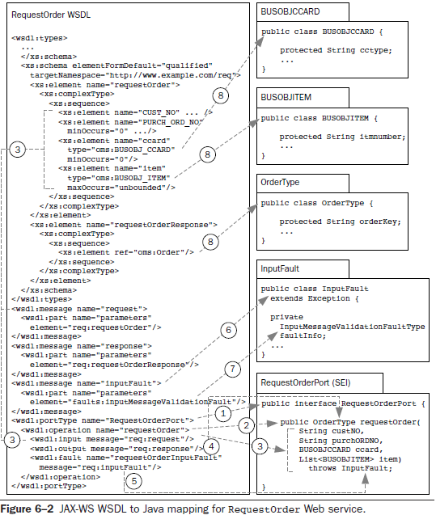
The JAX-WS WSDL to Java Mapping
RequestOrder.wsdl
The types and global elements defined in the wsdl:types section get mapped to Java classes
wsdl:message named inputFault gets mapped to the InputFault class
wsdl:portType element is mapped to the SEI RequestOrderPort
wsdl:operation is mapped to a SEI method of the same name
The element faults:inputMessageValidationFault maps to the fault bean named InputMessageValidationFaultType
The children of wrapper element req:requestOrder define the method parameters
Same
wsdl:fault maps to the "throws InputFault" clause of the requestOrder method declaration

Slide 6
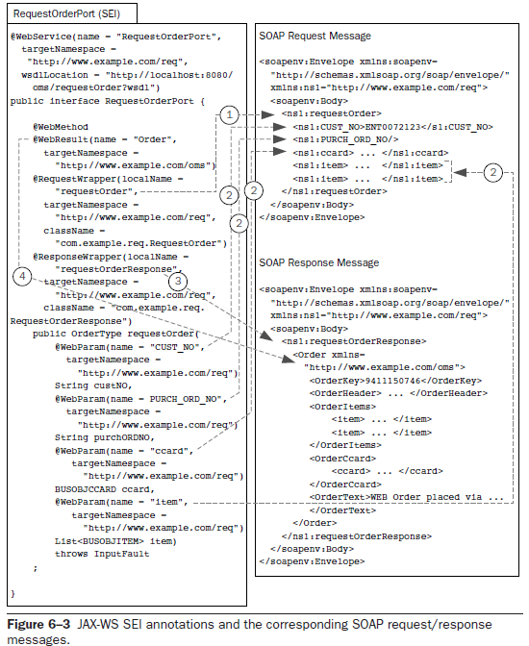

SEI Annotations example
RequestOrderPort.java
Defines the wrapper element for the SOAP request message
Map the parameters of a SEI method to the parameters of the SOAP request message
Defines the wrapper element for the SOAP response message
Maps the return value of a SEI method to corresponding child of the response wrapper element contained in the SOAP response message’s body

Slide 7
Annotation in SEI (1/3)
These annotations serve two purposes
  They annotate a SEI and determine, at runtime, how to map a method invocation to SOAP request/response messages
  However, these annotations are also used on the service side to deploy a Java class as a Web service
Essentially, the annotations are mapping a wsdl:operation to a Java method

Slide 8
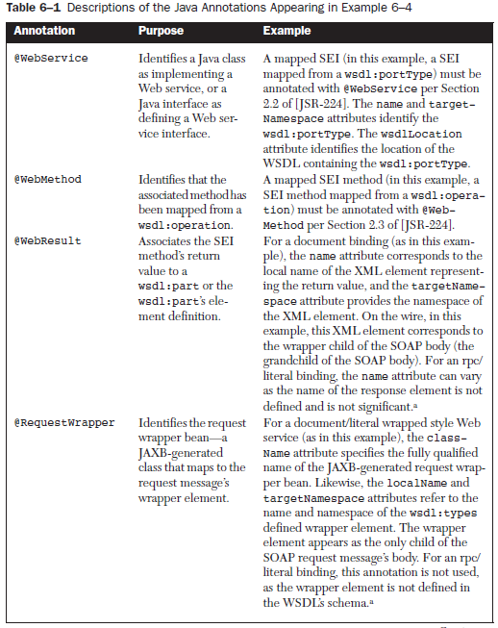
Annotation in SEI (2/3)

Slide 9
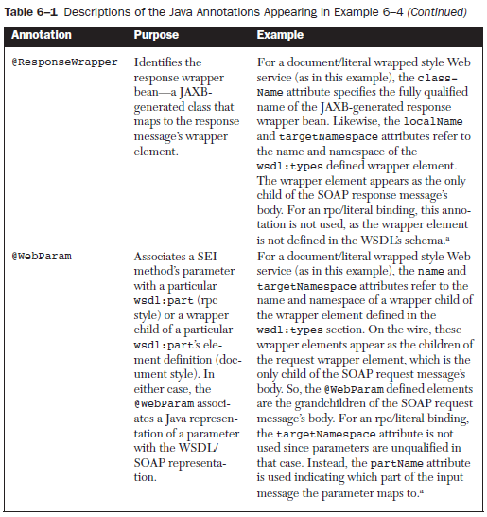
Annotation in SEI (3/3)

Slide 10
Invoking a Web Service with a Proxy
Client.java
First, injecting a Proxy instance with @WebServiceRef
Then, creating a Proxy instance
  Using a Generated Service
  Or, Using a Dynamically Configured Service
Finally, invoking a Web Service by using Proxy Instance
  Fault Handling is required

Slide 11
Injecting a Proxy Instance with @WebServiceRef
The @WebServiceRef annotation defines a reference to a Web service. It follows the resource pattern exemplified by the javax.annotation.Resource annotation
In Client.java, it annotates the field port of type RequestOrderPort (SEI). Using the @WebServiceRef annotation in this way, the container will inject a proxy instance implementing the SEI into the injection target port
When used in this manner, the value attribute of the annotation must refer to a generated service interface type (i.e., a subtype of javax.xml.ws.Service). The class specified here for the value attribute—RequestOrderService.class—was generated at the same time as the SEI by the wsimport utility
@WebServiceRef(RequestOrderService.class)
public static RequestOrderPort port;

Slide 12
Creating a Proxy Instance Using a Generated Service
The RequestOrderService generated class provides a getRequestOrderPort() method that returns an instance of RequestOrderPort
RequestOrderService service = new RequestOrderService();
RequestOrderPort port = service.getRequestOrderPort();
(new Tester()).runTests(port);

Slide 13
Creating a Proxy Instance Using a Dynamically Configured Service
Using this approach, Service.create() factory method is used to configure a Service instance using the WSDL’s URL and Qname of the wsdl:service
Technically, since the SEI is annotated with the WSDL’s URL, you don’t even need the URL parameter. However, in case the URL has changed since the SEI was generated, it is generally safer to specify the URL in this manner
Having created the Service instance, simply invoke the Service.getPort() method passing in the QName of the wsdl:portType and the SEI (e.g., RequestOrderPort.class). The Service instance, using the dynamic proxy, creates a proxy instance that you can cast to the SEI
URL wsdlURL = new URL("http://"+hostName+":"+portVal+"/chap06-endpoint-endpoint-1.0/requestOrder?wsdl");
QName serviceQName =
new QName("http://www.example.com/req", "RequestOrderService");
QName portQName =
new QName("http://www.example.com/req", "RequestOrderPort");
Service service = Service.create(wsdlURL, serviceQName);
RequestOrderPort port =
(RequestOrderPort) service.getPort(portQName, RequestOrderPort.class);
(new Tester()).runTests(port);

Slide 14
Calling Web Service by using Proxy Instance Tester.java
Proxy instance
public void runTests(RequestOrderPort port) throws Exception {
… // Some declarations
try { // Running test with expired credit card
order = port.requestOrder(
"ENT0072123", null, expiredCCard, itemList);
} catch (SOAPFaultException sfe) { // a runtime exception
processSOAPFault(sfe);
} catch (InputFault e) { // a checked exception
System.out.println("Error - should have thrown SOAPFault");
}
try { // Running test with null customer number
order = port.requestOrder(null, null, ccard, itemList);
} catch (InputFault ife) {
processInputFault(ife);
}
try { // Running test with a valid request
order = port.requestOrder("ENT0072123", null, ccard, itemList);
printReturnedOrder(order);
} catch (InputFault ife) {
processInputFault(ife);
}
Code to build JAXB instances
The Invoke with JAXB instances as params and return
Unmapped Exception
Mapped Exception
WebServiceException?

Slide 15
Limitation on Dynamic Proxies
Although dynamic proxies make Web services invocations look like standard Java method calls, along with this simplicity comes many constraints that can make SOA difficult
  First, the proxy approach requires that you use a SEI that was generated, according to the standard JAX-WS WSDL to Java mapping, from the target Web service’s WSDL
    The parameters and return types of the methods on such a SEI are classes that are created by the JAXB schema compiler from the wsdl:types section of the WSDL. These are not going to be the same classes you are using in your business today. You are going to be forced to write some custom middleware to translate between them
  Second, it is often preferable to work with XML messages directly, rather than with JAXB schema-generated classes.
    If XML document exists, the binding from XML to Java class is unnecessary. It would introduce a performance penalty and the potential for errors, especially in chaining together multiple Web services
  Third, you may want to write code that can dynamically invoke a Web service.
    That is, invoke a Web service without having generated and compiled a SEI prior to runtime. Such an approach is required, for example, when the WSDL is not known prior to runtime. This can happen when a target Web service is looked up, using a registry, at runtime. It is not possible to invoke such “late binding” Web services using the SEI approach

